Slide 1







HTTP and REST
HTTP, RESTful Web Services, HTTP and REST Tools: Postman, Fiddler
HTTP and REST
SoftUni Team
Technical Trainers
Software University
http://softuni.bg

Slide 2



Table of Contents
The HTTP Protocol
HTTP Developer Tools
REST and RESTful Services
Accessing the GitHub API
Using Firebase BaaS
Using Kinvey mBaaS
<number>

Slide 3
Have a Question?
sli.do #JSAPPS
<number>

Slide 4



HTTP Basics
HTTP (Hyper Text Transfer Protocol)
Text-based client-server protocol for the Internet
For transferring Web resources (HTML files, images, styles, etc.)
Request-response based
HTTP request
HTTP response
Web Client
Web Server
<number>

Slide 5






HTTP Request Methods
HTTP defines methods to indicate the desired action to be performed on the identified resource
Method | Description
GET | Retrieve / load a resource
POST | Create / store a resource
PUT | Update a resource
DELETE | Delete (remove) a resource
PATCH | Update resource partially
HEAD | Retrieve the resource's headers
<number>

Slide 6
HTTP GET Request – Example
GET /users/testnakov/repos HTTP/1.1
Host: api.github.com
Accept: */*
Accept-Language: en
Accept-Encoding: gzip, deflate
User-Agent: Mozilla/5.0 (Windows NT 10.0; WOW64) AppleWebKit/537.36 (KHTML, like Gecko) Chrome/54.0.2840.71 Safari/537.36
Connection: Keep-Alive
Cache-Control: no-cache
<CRLF>
HTTP request line
HTTP headers
The request body is empty
<number>

Slide 7
HTTP POST Request – Example
POST /repos/testnakov/test-nakov-repo/issues HTTP/1.1
Host: api.github.com
Accept: */*
Accept-Language: en
Accept-Encoding: gzip, deflate
User-Agent: Mozilla/4.0 (compatible;MSIE 6.0; Windows NT 5.0)
Connection: Keep-Alive
Cache-Control: no-cache
<CRLF>
{"title":"Found a bug",
"body":"I'm having a problem with this.",
"labels":["bug","minor"]}
<CRLF>
HTTP request line
HTTP headers
The request body holds the submitted data
<number>

Slide 8
HTTP Response – Example
HTTP response status line
HTTP/1.1 200 OK
Date: Fri, 11 Nov 2016 16:09:18 GMT+2
Server: Apache/2.2.14 (Linux)
Accept-Ranges: bytes
Content-Length: 84
Content-Type: text/html
<CRLF>
<html>
<head><title>Test</title></head>
<body>Test HTML page.</body>
</html>
HTTP response headers
HTTP response body
<number>

Slide 9
HTTP Response Status Codes
Status Code | Action | Description
200 | OK | Successfully retrieved resource
201 | Created | A new resource was created
204 | No Content | Request has nothing to return
301 / 302 | Moved | Moved to another location (redirect)
400 | Bad Request | Invalid request / syntax error
401 / 403 | Unauthorized | Authentication failed / Access denied
404 | Not Found | Invalid resource
409 | Conflict | Conflict was detected, e.g. duplicated email
500 / 503 | Server Error | Internal server error / Service unavailable
<number>
Notes:
© Software University Foundation – http://softuni.org
This work is licensed under the Creative Commons Attribution-NonCommercial-ShareAlike license.
<number>

Slide 10
Content-Type and Disposition
The Content-Type / Content-Disposition headers specify how the HTTP request / response body should be processed
Examples:
JSON-encoded data
UTF-8 encoded HTML page. Will be shown in the browser
Content-Type: application/json
Content-Type: text/html; charset=utf-8
Content-Type: application/pdf
Content-Disposition: attachment; filename="Financial-Report-April-2016.pdf"
This will download a PDF file named Financial-Report-April-2016.pdf
<number>

Slide 11


HTTP Developer Tools
Chrome Dev Tools, Fiddler, Postman

Slide 12
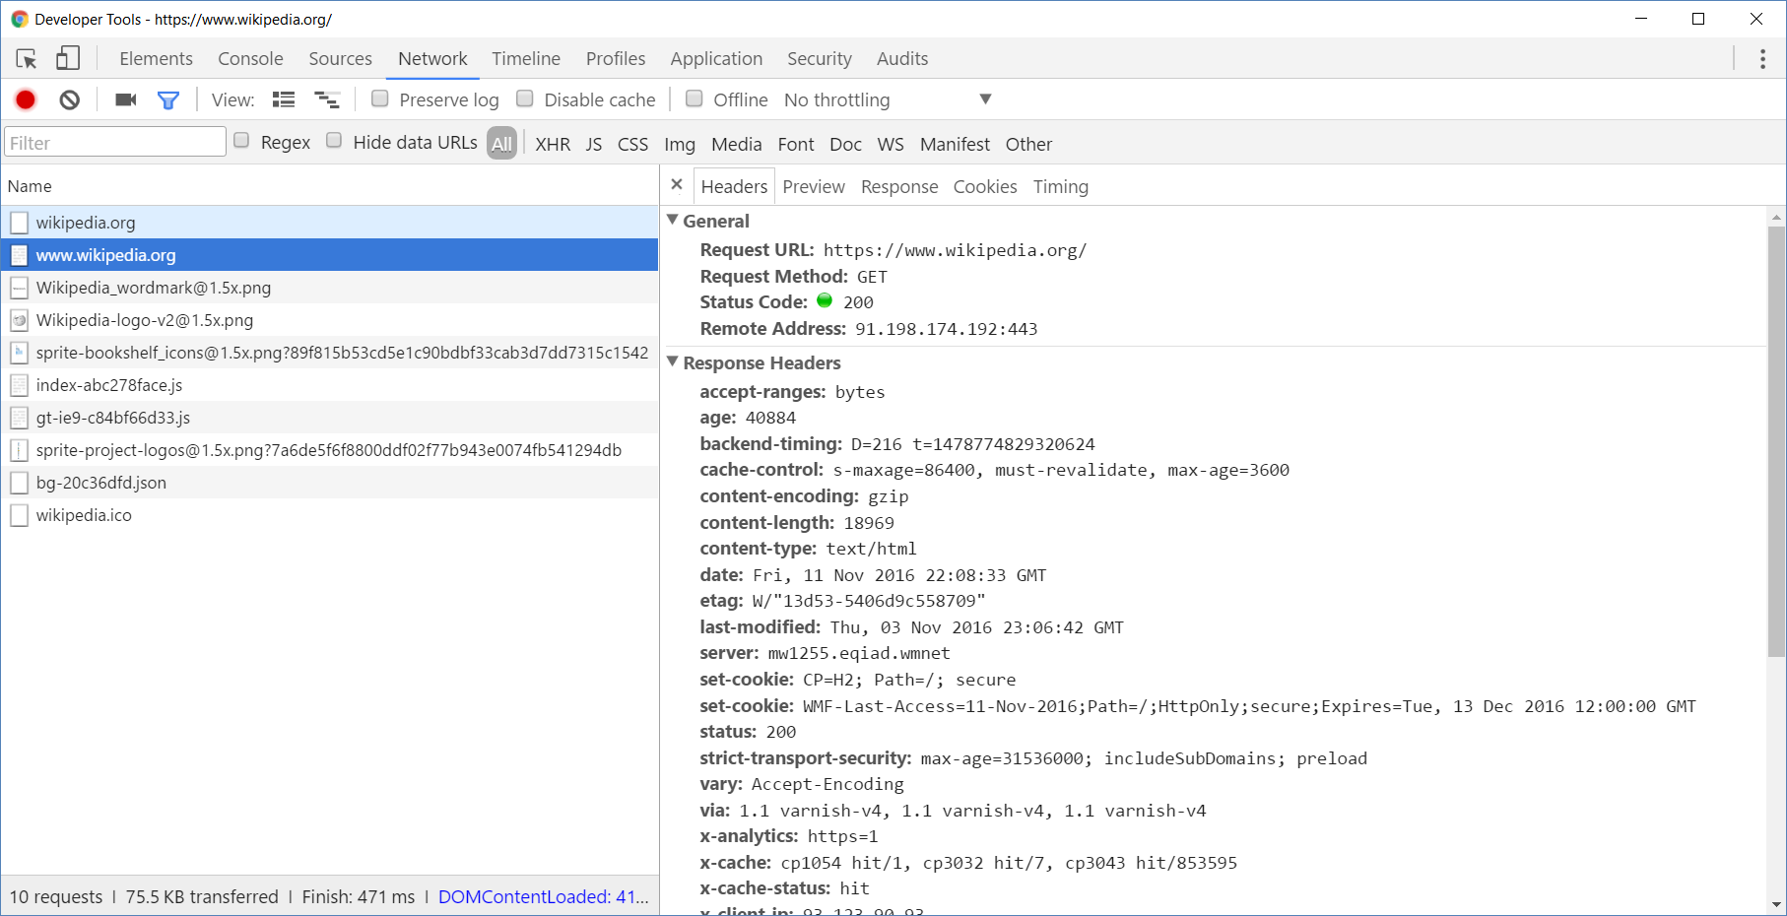
Chrome Developer Tools
Chrome Developer Tools
<number>

Slide 13
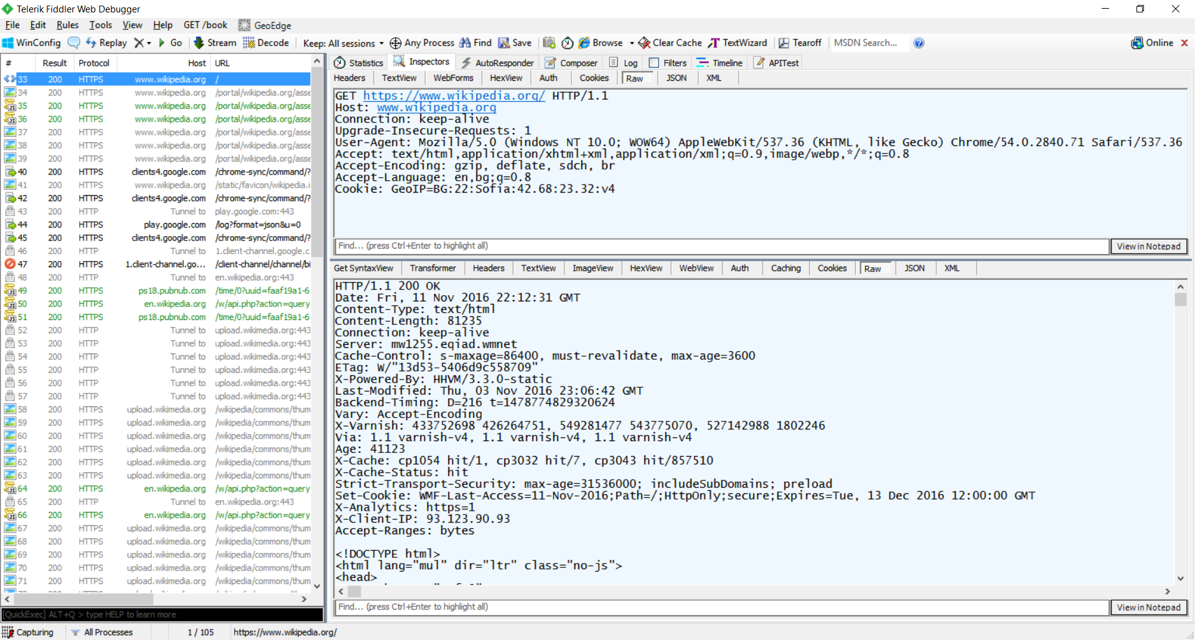

Fiddler
Fiddler
<number>

Slide 14
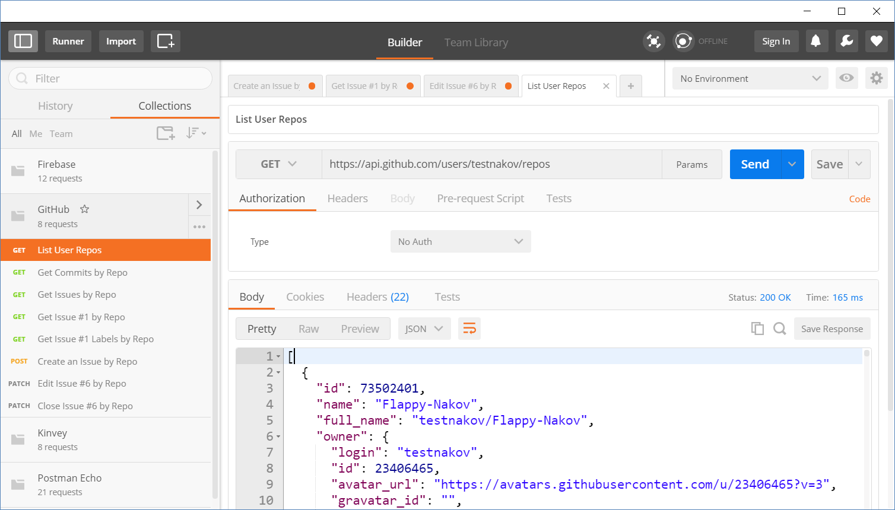
HTTP Tools for Developers
Postman REST Client
<number>

Slide 15
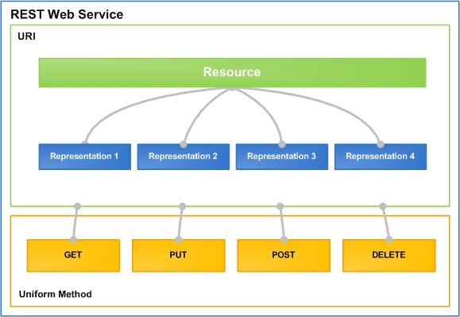
REST and RESTful Services
Representational State Transfer (REST)
Architecture for client-server communication over HTTP
Resources have URI (address)
Can be created / retrieved / modified / deleted / etc.
RESTful API / RESTful Service
Provides access to server-side resources via HTTP and REST
<number>

Slide 16

REST and RESTful Services – Example
Create a new post
POST http://some-service.org/api/posts
Get all posts / specific post
GET http://some-service.org/api/posts
GET http://some-service.org/api/posts/17
Delete existing post
DELETE http://some-service.org/api/posts/17
Replace / modify existing post
PUT / PATCH http://some-service.org/api/posts/17
<number>

Slide 17

GitHub REST API
Accessing GitHub through HTTP

Slide 18
GitHub API
List user's all public repositories:
Get all commits from a public repository:
Get all issues / issue #1 from a public repository
GET
https://api.github.com/users/testnakov/repos
GET
https://api.github.com/repos/testnakov/softuniada-2016/commits
GET
/repos/testnakov/test-nakov-repo/issues
/repos/testnakov/test-nakov-repo/issues/1
Check your solution here: https://judge.softuni.bg/Contests/356
<number>

Slide 19
GitHub API (2)
Get all labels for certain issue from a public repository:
Create a new issue to certain repository (with authentication)
GET
https://api.github.com/repos/testnakov/test-nakov-repo/issues/1/labels
POST
https://api.github.com/repos/testnakov/test-nakov-repo/issues
Headers
Authorization: Basic base64(user:pass)
Body
{"title":"Found a bug",
"body": "I'm having a problem with this."}
Check your solution here: https://judge.softuni.bg/Contests/356
<number>

Slide 20
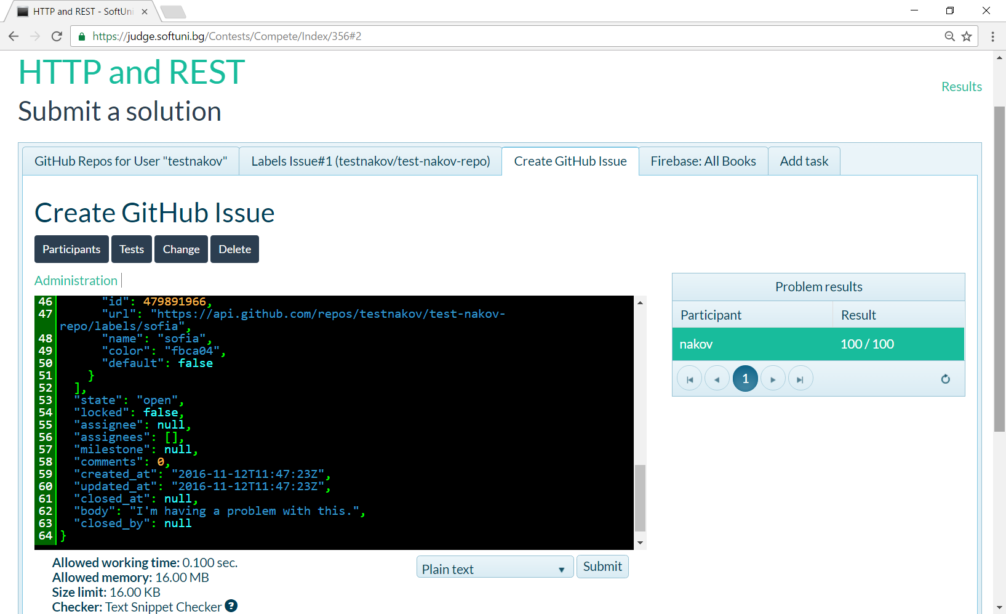
Submitting Problems to the Judge
Submit the result of your request (the returned HTTP response)
<number>

Slide 21

Firebase
Real-Time Cloud DB and App Platform by Google

Slide 22
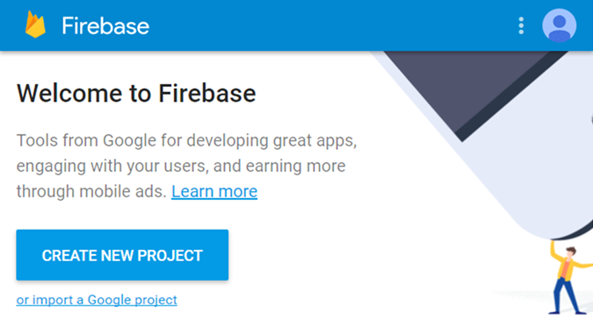
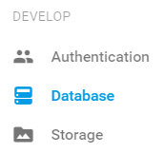
Firebase
Firebase is a cloud-based DB, storage and app platform (BaaS)
REST API, JSON-based document DB, free and paid plans
Register at https://console.firebase.google.com
Create a new project and play with it
<number>

Slide 23
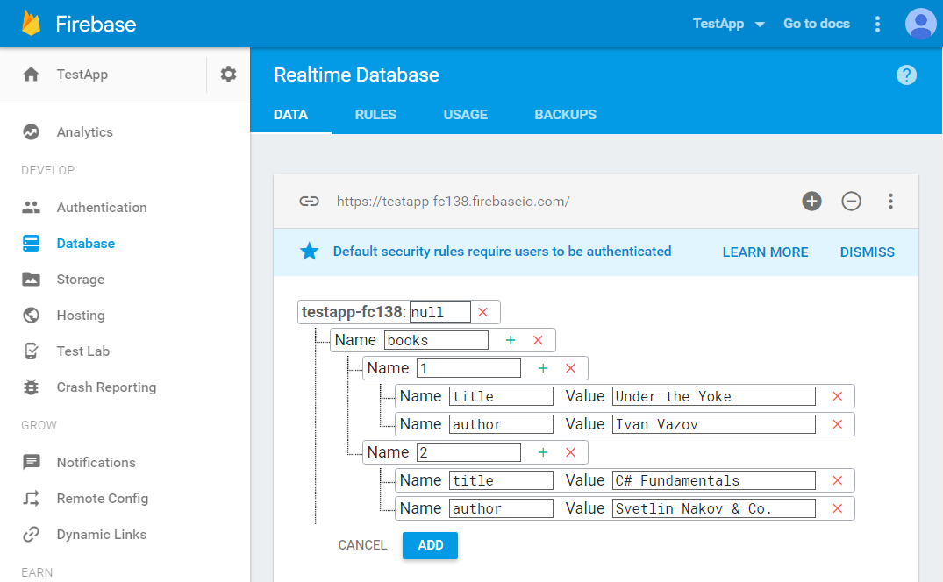
Firebase – Put Some Data in the DB
This is your DB URL
The data is a hierarchical key-value structure (tree)
<number>

Slide 24
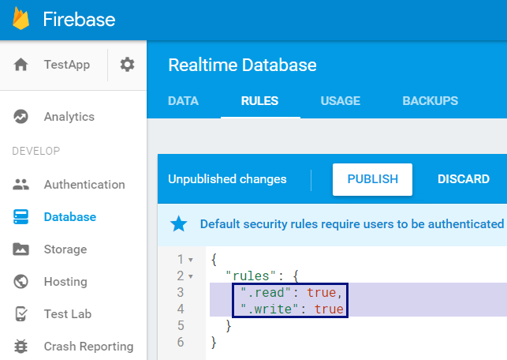
Firebase REST API
Enable unauthorized access to your DB
For educational purposes only!
This is a security hole, don't do it in real apps
Access your data through the REST API
GET
https://testapp-fc138.firebaseio.com/.json
<number>

Slide 25
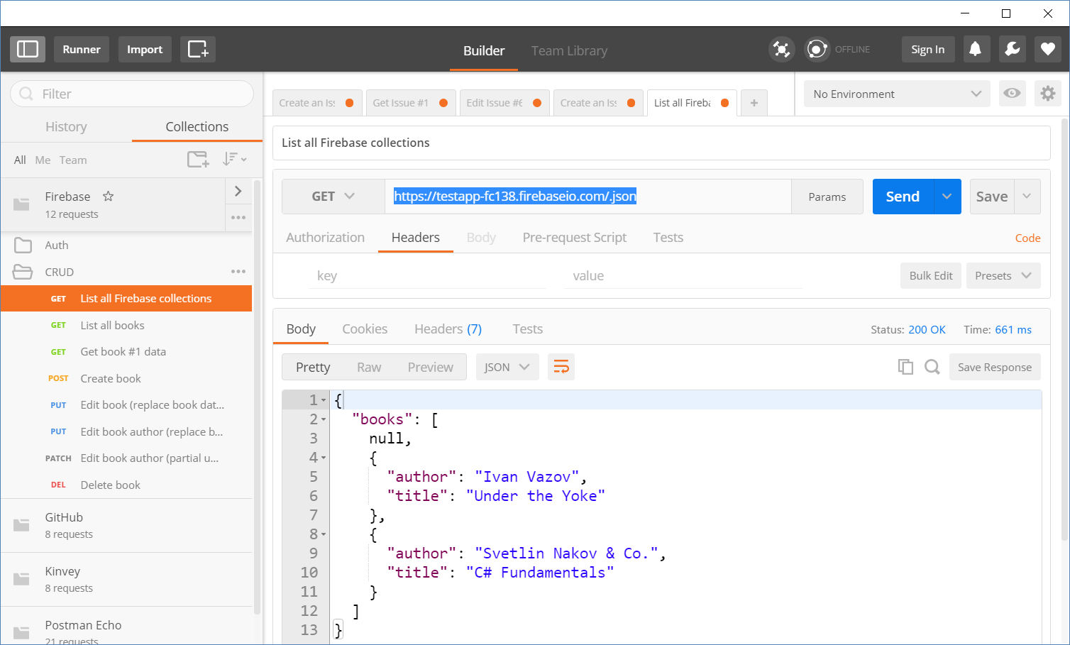
Accessing Firebase REST API with Postman
Append .json to your DB object URL
<number>

Slide 26
Firebase REST API – CRUD Operations
GET
https://testapp-fc138.firebaseio.com/.json
GET
https://testapp-fc138.firebaseio.com/books.json
GET
https://testapp-fc138.firebaseio.com/books/1.json
GET
https://testapp-fc138.firebaseio.com/books/1/author.json
POST
https://testapp-fc138.firebaseio.com/books.json
Body
{"title":"New title", "author":"New author"}
DELETE
https://testapp-fc138.firebaseio.com/books/6.json
Check your solution here: https://judge.softuni.bg/Contests/356
<number>

Slide 27
Firebase REST API – CRUD Operations (2)
PUT
https://testapp-fc138.firebaseio.com/books/7.json
Body
{"title":"Edited title", year:1980, ISBN:"954X"}
PATCH
https://testapp-fc138.firebaseio.com/books/7.json
Body
{"year":1981, "author":"Author Changed"}
PUT
https://testapp-fc138.firebaseio.com/books/7/author.json
Body
"New author was assigned"
DELETE
https://testapp-fc138.firebaseio.com/books/7/author.json
Check your solution here: https://judge.softuni.bg/Contests/356
<number>

Slide 28
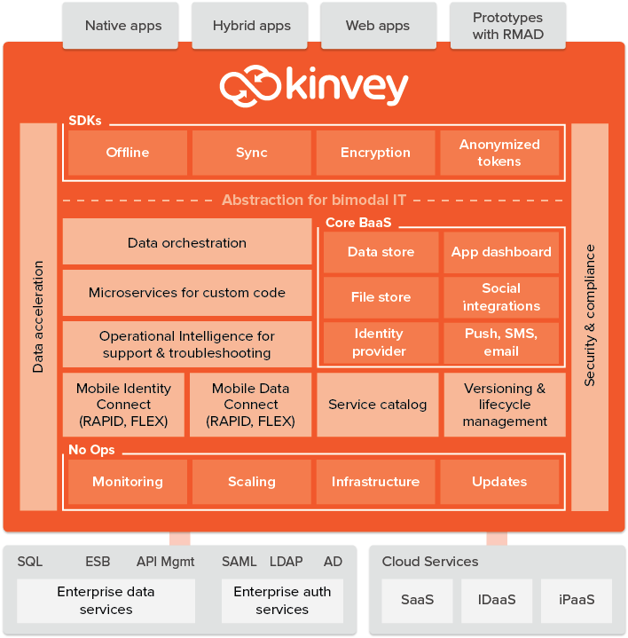
Kinvey
Collection-Based Cloud DB (mBaaS)

Slide 29
Kinvey as JS Back-End
Kinvey is a Mobile Back-End as a Service (mBaaS)
Holds your app / mobile app data in the cloud
Anyone can register and create an app
Kinvey apps hold users and user data
Users (API for creating an account)
Data collections (API for CRUD operations)
Files (upload / download / delete)
<number>

Slide 30
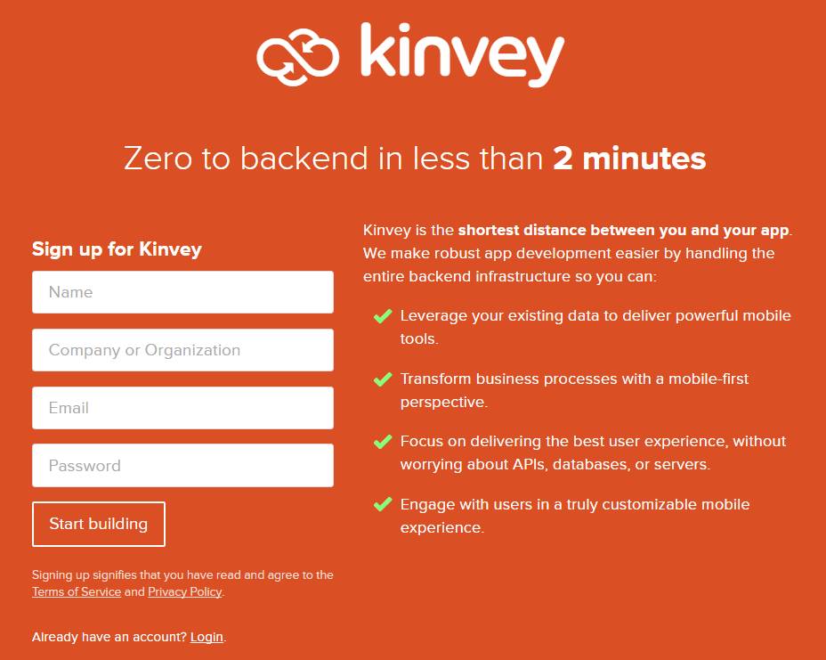
Kinvey: Registration
Create a developer account in Kinvey
https://console.kinvey.com/sign-up
<number>

Slide 31
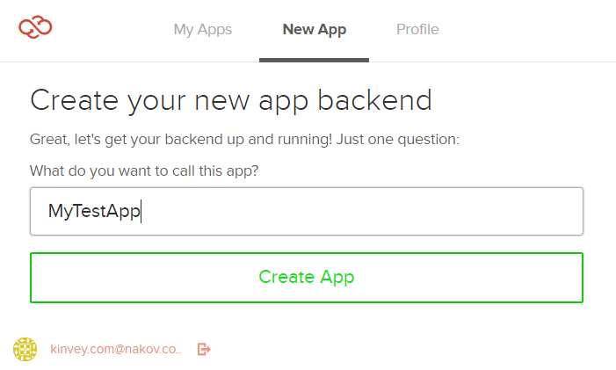
Kinvey: Create an App Backend
Create an app backend (e.g. MyTestApp)
https://console.kinvey.com/apps/new
You get App ID + App secret keys (account)
<number>

Slide 32
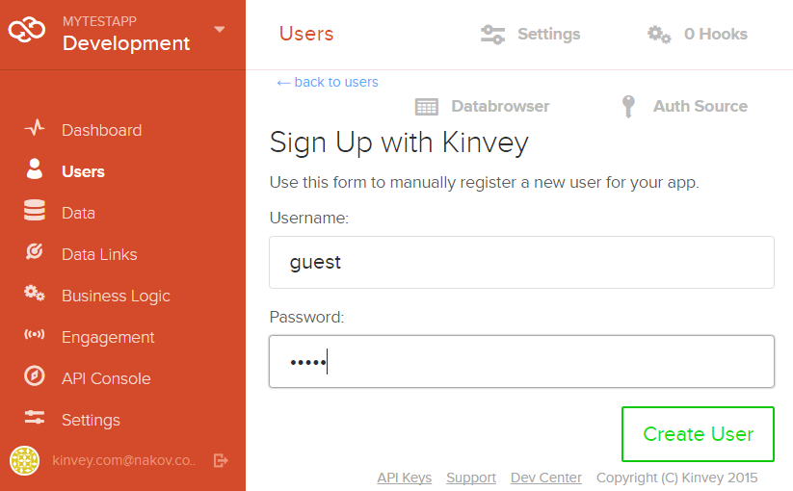
Kinvey: Create a User
Create a user (e.g. guest / guest)
<number>

Slide 33
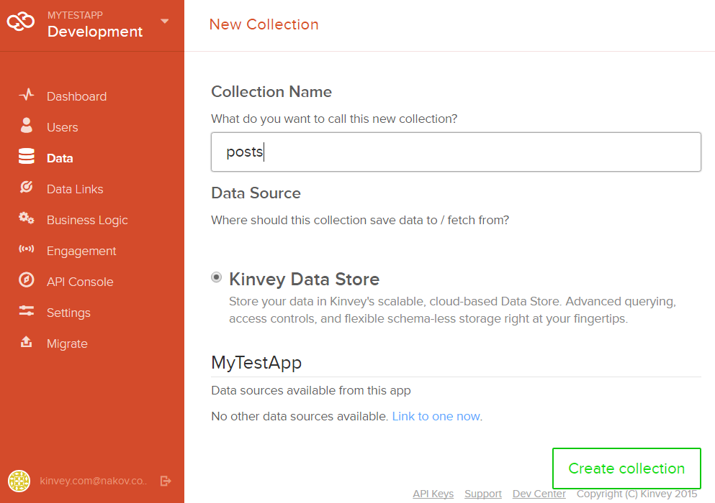
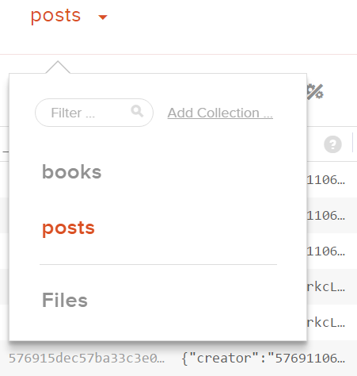
Kinvey: Create a Data Collection
Create a data collection (e.g. posts)
<number>

Slide 34
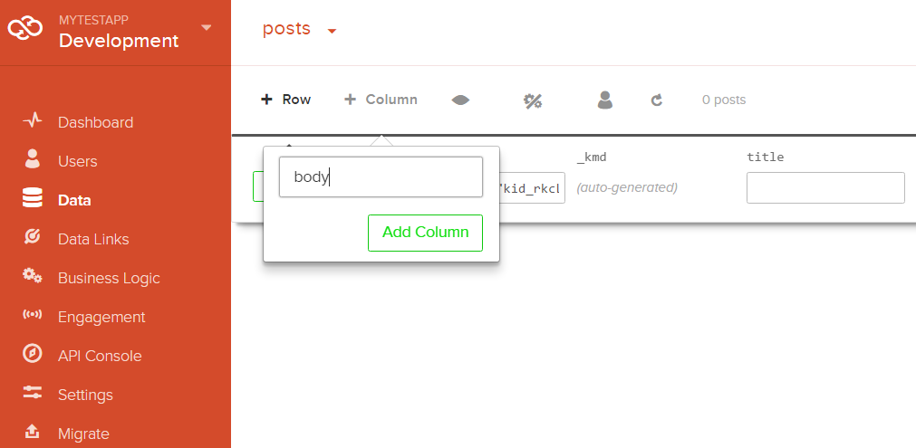
Kinvey: Create Data Columns
Create some data columns for the posts, e.g. title and body
<number>

Slide 35
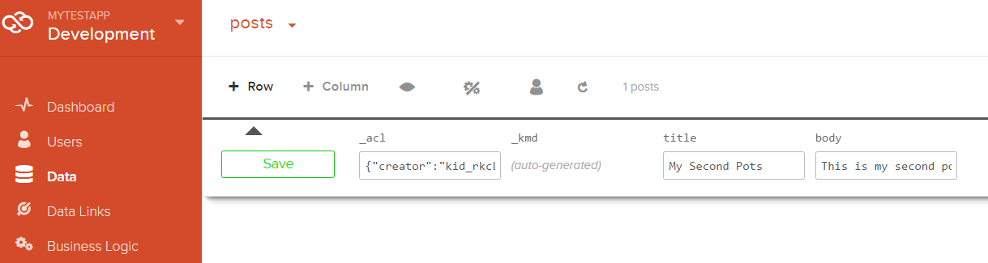
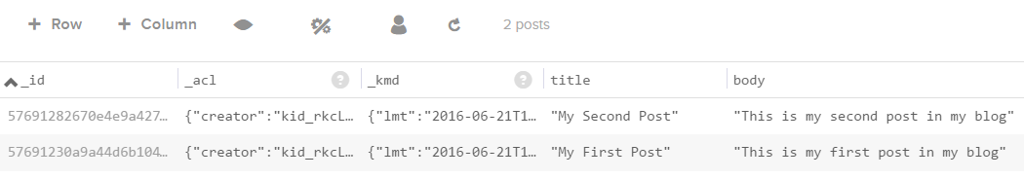
Kinvey: Create Data Rows
Create some data rows for the posts collection
<number>

Slide 36
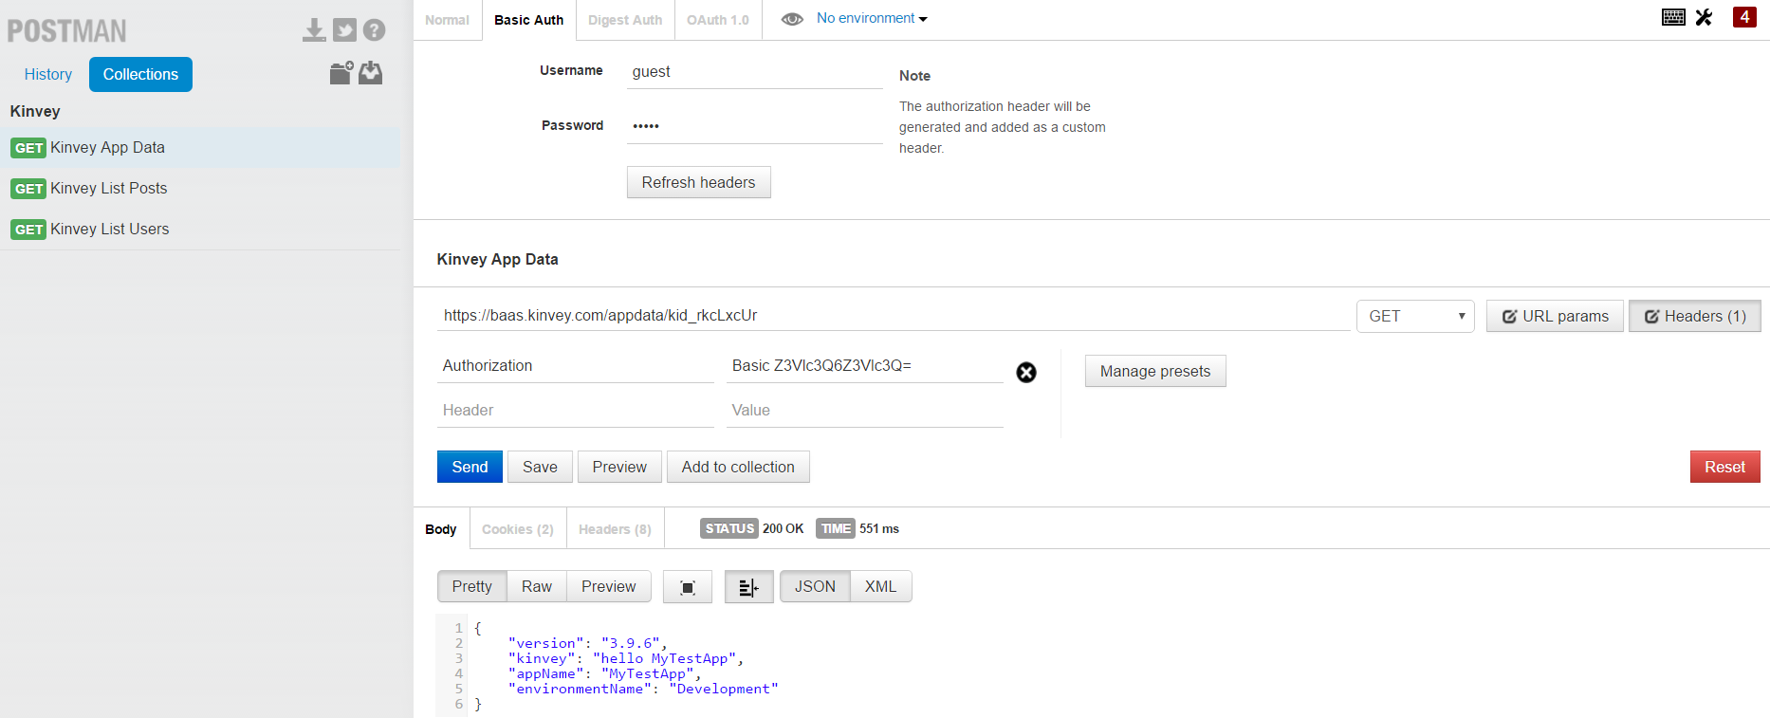

Test Your Backend with Postman
Basic authentication user: guest
pass: guest
https://baas.kinvey.com/appdata/{app_id}
Check your solution here: https://judge.softuni.bg/Contests/356
<number>

Slide 37
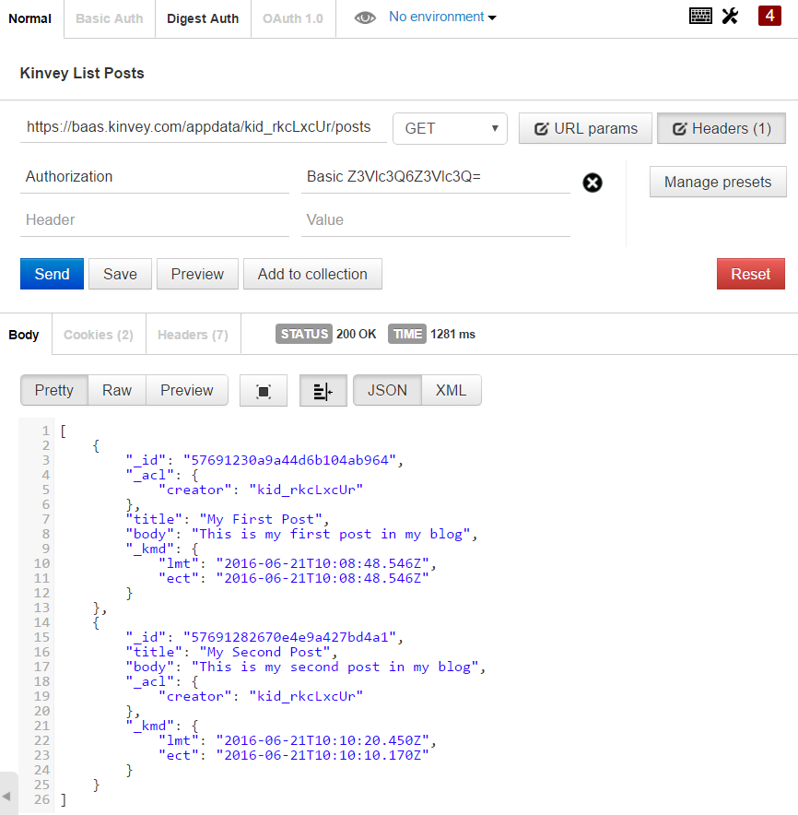
Kinvey and Postman: List All Posts
URL: https://baas.kinvey.com/appdata/{app_id}/posts
Method: GET
Authentication: Basic
User: guest
Pass: guest
Check your solution here: https://judge.softuni.bg/Contests/356
<number>

Slide 38
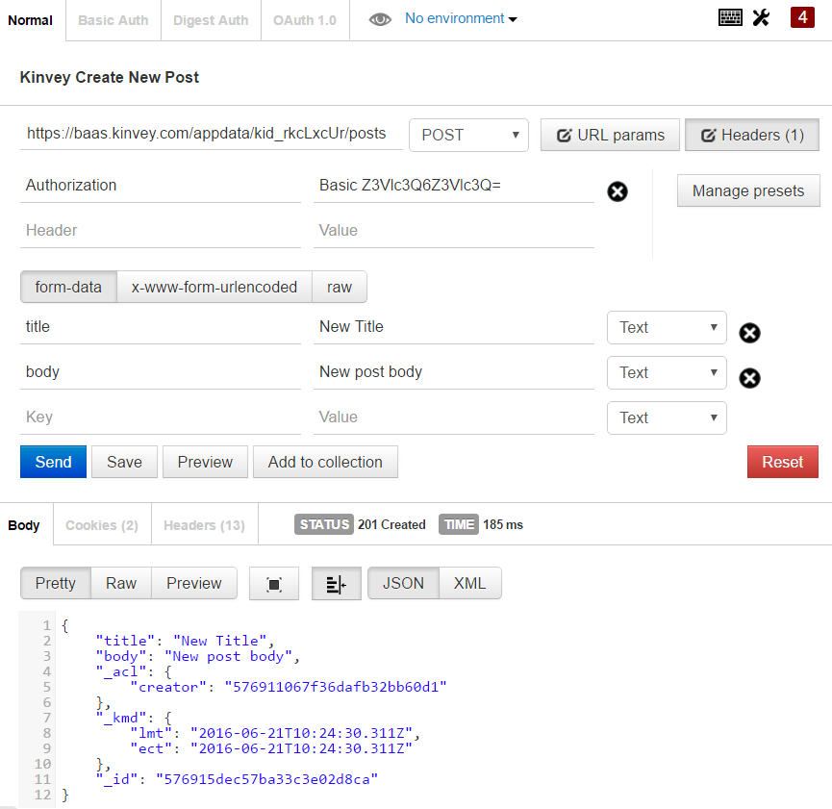
Kinvey and Postman: Create a New Post
URL: https://baas.kinvey.com/appdata/{app_id}/posts
Method: POST
Authentication: Basic
User / pass: guest / guest
Request body
title: New Title
body: New Post Body
Check your solution here: https://judge.softuni.bg/Contests/356
<number>

Slide 39
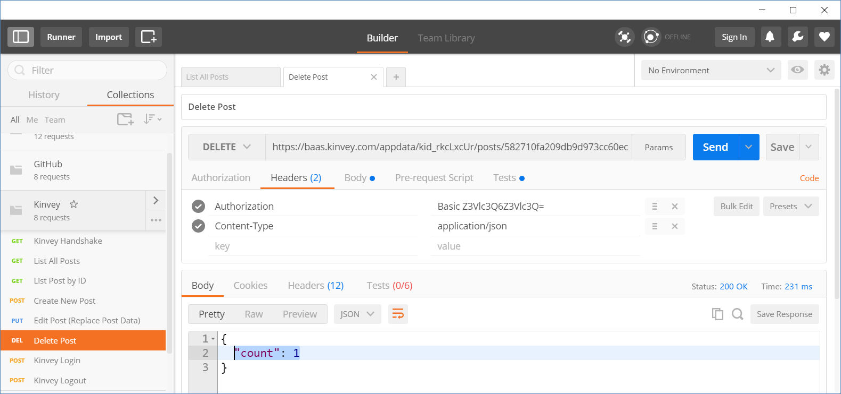
Kinvey and Postman: Delete an Existing Post
URL: https://baas.kinvey.com/appdata/{app_id}/posts/id
Choose an existing post's ID
Method: DELETE
Authentication: Basic
User / pass: guest / guest
Body: (empty)
Check your solution here: https://judge.softuni.bg/Contests/356
<number>

Slide 40
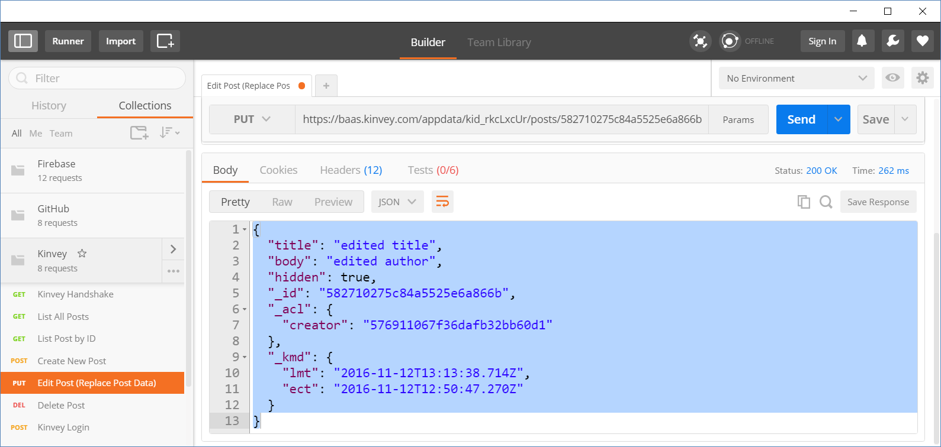
Kinvey and Postman: Edit an Existing Post
URL: https://baas.kinvey.com/appdata/{app_id}/posts/id
Choose an existing post's ID
Method: PUT
Authentication: Basic
User / pass: guest / guest
Body (JSON):
{"title":"edited title", "body":"edited author", "hidden":true}
Check your solution here: https://judge.softuni.bg/Contests/356
<number>

Slide 41
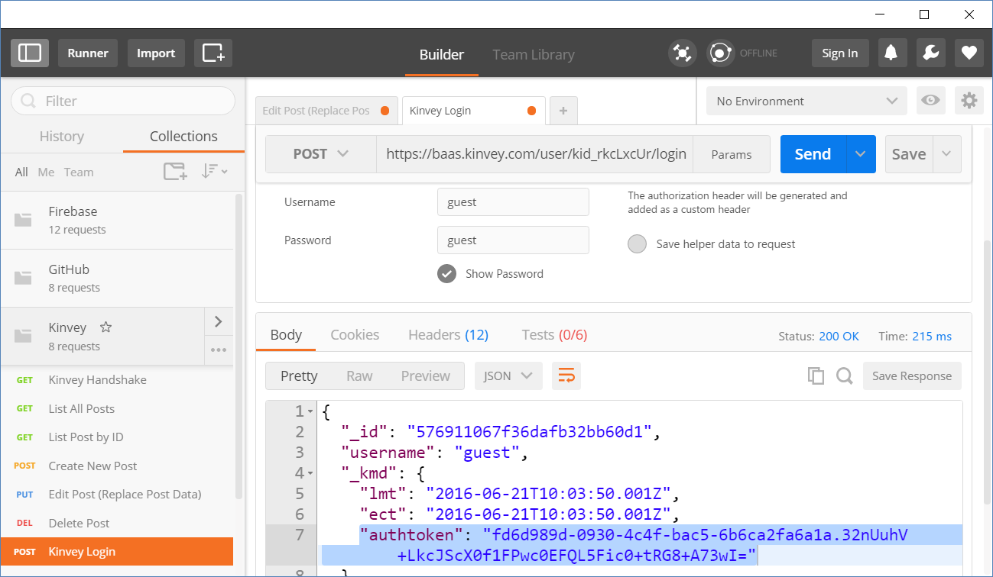
Kinvey and Postman: Login
URL: https://baas.kinvey.com/user/{app_id}/login
Method: POST
Authentication: Basic
User / pass: app_id : app_secret
Body:
Returns: authtoken, e.g.
{"username":"…", {"password":"…"}
"authtoken": "fd6d989d-0930-4c…wI="
Check your solution here: https://judge.softuni.bg/Contests/356
<number>

Slide 42
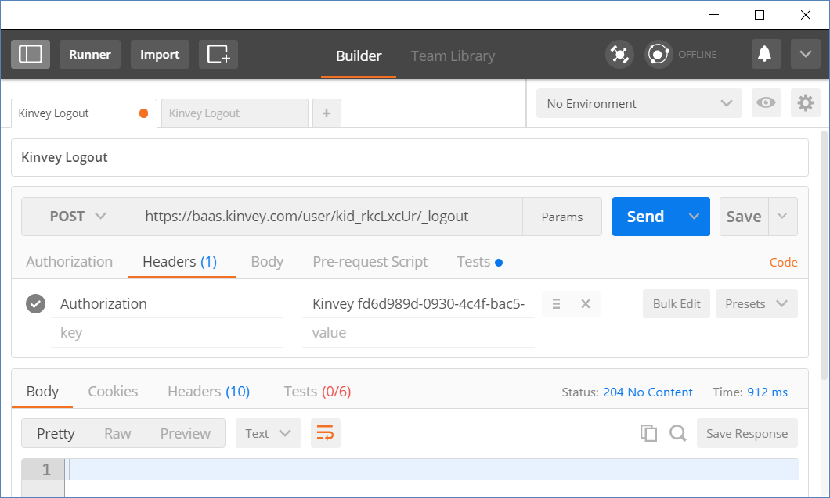
Kinvey and Postman: Logout
URL: https://baas.kinvey.com/user/{app_id}/_logout
Method: POST
Authorization:
Kinvey <authtoken>
Use the token given by the login request
Returns:
204 No Content
Authorization: Kinvey <authtoken>
<number>

Slide 43




Practice: Accessing the REST API from GitHub, Firebase, Kinvey
Live Exercises in Class (Lab)

Slide 44


Summary
HTTP is text-based request-response protocol
REST uses GET, POST, PUT, PATCH, DELETE
RESTful services address resources by URL
Provide CRUD operations over HTTP
GitHub API provides access to users, organizations, repos, commits, issues, wikis, gist, pull requests, …
Firebase is JSON-based cloud database (mBaaS) with REST API
Kinvey is collection-based could database (mBaaS)
<number>

Slide 45







HTTP and REST
https://softuni.bg/courses/
Notes:
© Software University Foundation – http://softuni.org
This work is licensed under the Creative Commons Attribution-NonCommercial-ShareAlike license.
<number>

Slide 46
License
This course (slides, examples, demos, videos, homework, etc.) is licensed under the "Creative Commons Attribution-NonCommercial-ShareAlike 4.0 International" license
<number>
Notes:
© Software University Foundation – http://softuni.org
This work is licensed under the Creative Commons Attribution-NonCommercial-ShareAlike license.
<number>

Slide 47





Free Trainings @ Software University
Software University Foundation – softuni.org
Software University – High-Quality Education, Profession and Job for Software Developers
softuni.bg
Software University @ Facebook
facebook.com/SoftwareUniversity
Software University Forums
forum.softuni.bg
Notes:
© Software University Foundation – http://softuni.org
This work is licensed under the Creative Commons Attribution-NonCommercial-ShareAlike license.
<number>

